Slide 1
EDA Capstone Project -Hotel Booking Analysis
Name :- Udaya Bhat

Slide 2
Points for discussion
Data Summary
Hotel wise analysis
Distribution Chanel wise analysis
Cancelation Analysis
Preferred meal type for different customer type
Most visitor from the country
ADR vs length of stay

Slide 3
Data Summary
Hotel Bookings Analysis project consists with the real - world data record of hotel bookings of a city hotel and a resort hotel for the period 2015 - 2017 respectively. The project data record consists of information such as type of hotel booked, average daily rate, booking details, arrival date, length of the stay, the number of adults, children, and / or babies booked, customer country, meal preferences, type of the customer, parking space details, reservation status, channels used for booking, booking cancellation details, booking lead time details, Room preferences etc.

Slide 4
Hotel Wise stats
We have analyzed data from 2015 - 2017 of city hotel and resort hotel Bookings and tried to answer the following Question
Which Hotel has more bookings?
Which hotel makes more revenue?
Which hotel has maximum cancellation percentage ?

Slide 5
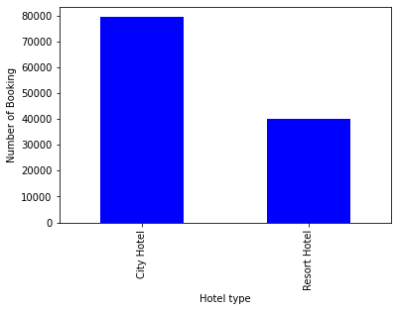
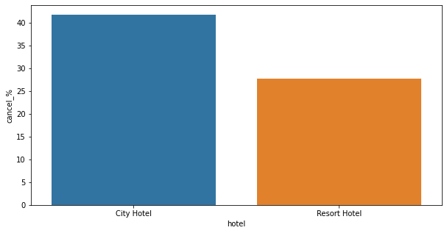
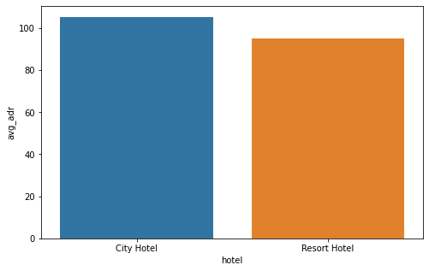
Hotel Wise Analysis
Bookings are more in city hotel compared to resort hotel
-
Cancellation are also more in city hotel compared to resort hotel
City hotel making slightly more revenue compared to resort hotel

Slide 6
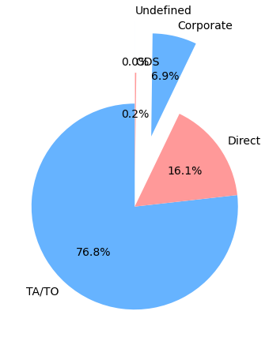
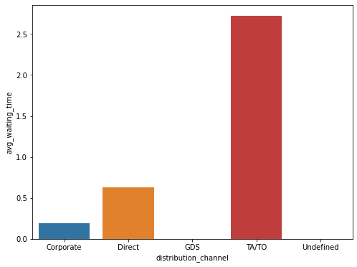
Distribution Channel wise analysis
more number of booking are made by Travel agencies (TA/TO)which is almost 75% where direct booking is 16%
After studying avg waiting time among all distribution channel it is understood that Travel agencies have more waiting time than other distribution channel

Slide 7
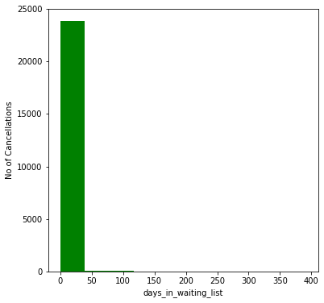
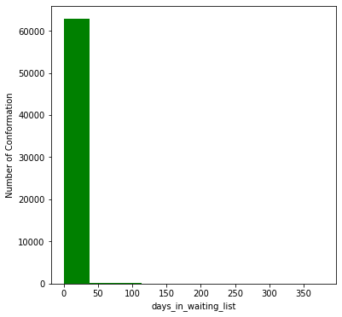
Cancelation Analysis
Studied Cancellation trends among the hotels we came to know that cancellations are more in city hotel compared to resort hotel
After analyzing both histogram chart, its understood that both cancelation and confirmation frequency lies between waiting time range 0-150 days so we can conclude that cancellation has no relation with waiting time

Slide 8
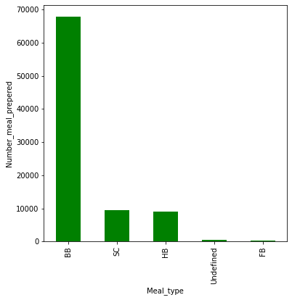
Preferred meal type
Most customers prefer Bread & Breakfast (BB) Type meal

Slide 9
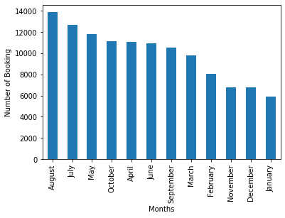
Month wise booking
Analysis reveals that August is the busiest month followed by July where January is least busy in hotel bookings

Slide 10
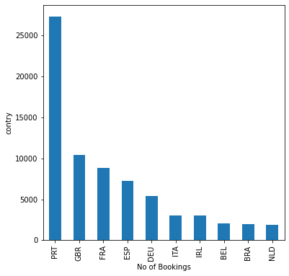
Country wise booking
More number of customers are from Portugal followed by Brittan and France

Slide 11
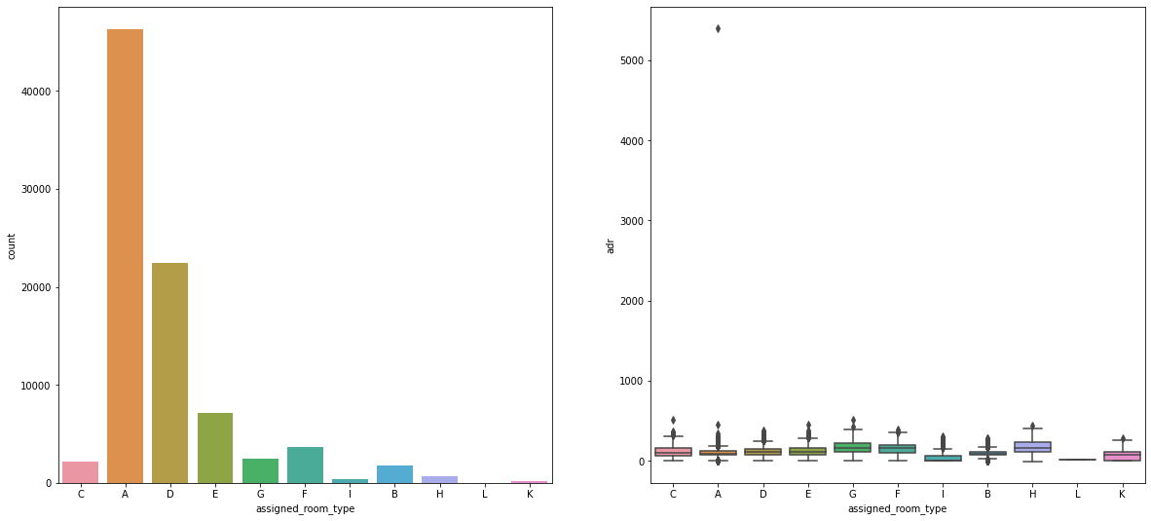
Analysis on room type
From the above graphs, we can identify that room type A is the most demanded rooms by the customer while booking, whereas room types H,G,C are generating more Adr respectively

Slide 12
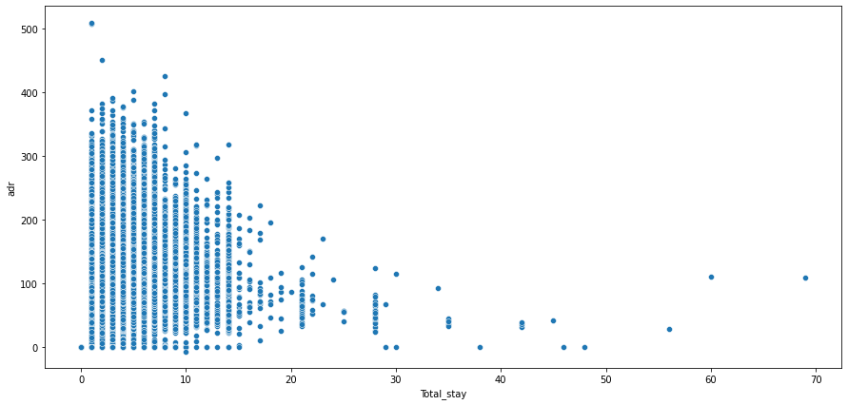
Length of stay vs Adr
From the scatter plot we can conclude that length of total stay increases, adr decreases. Customers who stay less, pays more

Slide 13
Solution to Business Objective
Anyone is thinking to start new Hotel business can opt to city hotel over to resort hotel as they get more customers also city hotels generates more revenue
As Most customers prefer Bread & Breakfast (BB) meal , Hotels can give some attractive deal on upon choosing this BB type meal which will help to attract more customers
August is the busiest month followed by July in terms of number of visitors in this case hotel owner can make his team ready to give optimum service to customer and can also utilize this high demand of hotel rooms to make more profit Hotel owners can give exclusive offers at low demand time to attract a greater number of customers to ensure his business to run steadily
Most visitors are from Portugal and other European countries so its better to hotel management to ensure that facilities according to their requirement also can-do good marketing at that countries to enhance business
room type A is the most demanded rooms by the customer while booking, whereas room types H,G,C are generating more adr respectively Hotel management should try to increase room types A, to ensure no customer is missed because of unavailability of specific type of rooms. as room type H generating more revenue can give some addon facility to for H type room in order attracts more customer for this specific room type
We saw more number of bookings are done by using distribution channel TA/TO where Hotel must share its revenue in terms of commission The hotel management can offer discounts, complimentary services and offers on direct bookings as the hotel doesn’t pay commissions to third parties and maintains a direct relationship with the customer when a customer books the hotel directly
Most preferred stay in hotels is 3 days, hotel management should introduce loyalty service, offers, tourism package in order to increase the stay of customers and to generate more revenue

Slide 14
Solution to Business Objective
August and July are the busiest month in terms of hotel business so we can anticipate high price of hotel rooms, where January is slack season, we can expect lower price for hotel rooms
Most of the bookings are for City Hotel compared to Resort Hotel .
Most customers prefer Bread & Breakfast (BB) meal
Most preferred distribution channel by customers is Travel Agent / Tour Operator (TA/TO) to make hotel booking.
Most of the customers are from Portugal.
Most preferred stay in hotels is 3 days
cancelation and confirmation frequency lies between waiting time range 0-150 days so we can conclude that cancellation has no relation with waiting time

